Slide 1
Deliverando Sales Analysis
by: Marcio A. Ballesteros M.

Slide 2

Active Restaurants Analysis:
Number of Active restaurants Deliverando :
232 1st M. Restaurants → 238 Restaurants in 2nd. M.
2.56 % incresed & 221 Restaurants Active in both months
Number of Active restaurants Competition:
290 1st M. Restaurants → 301 Restaurants in 2nd. M.
3.7% incresed & 232 Restaurants Active in both Months

Slide 3
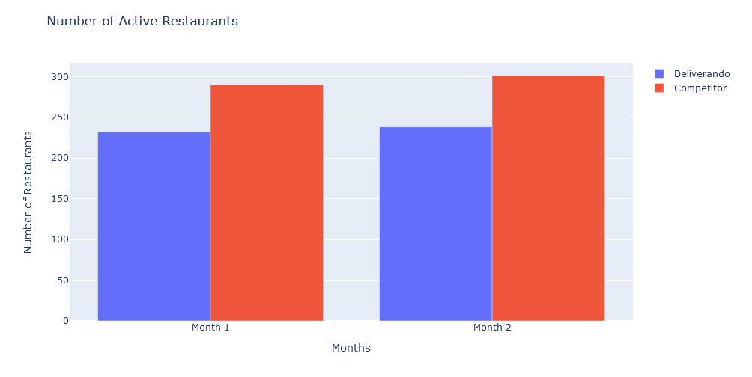
Deliverando vs competition

Slide 4

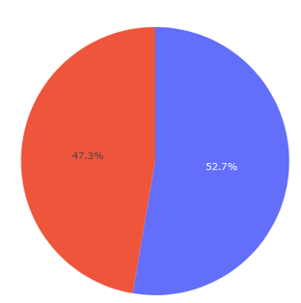
Deliverando vs Competitors
Restaurant distribution

Slide 5
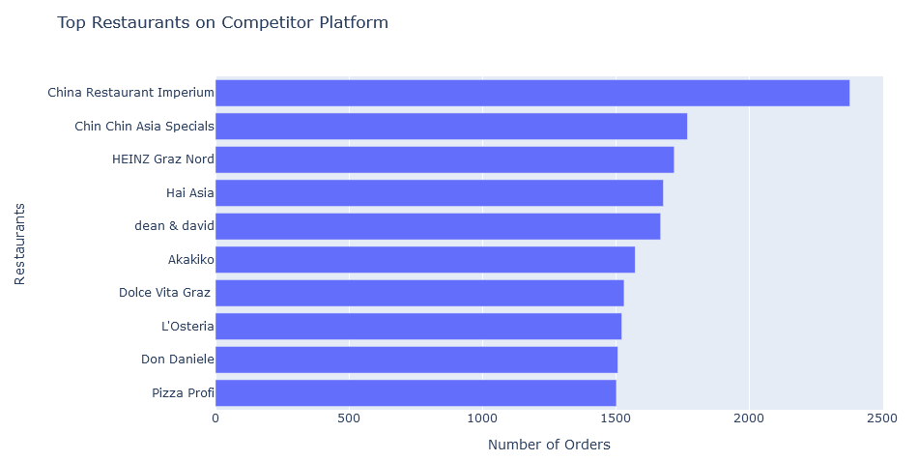
Top Restaurants on Competitor Platform

Slide 6
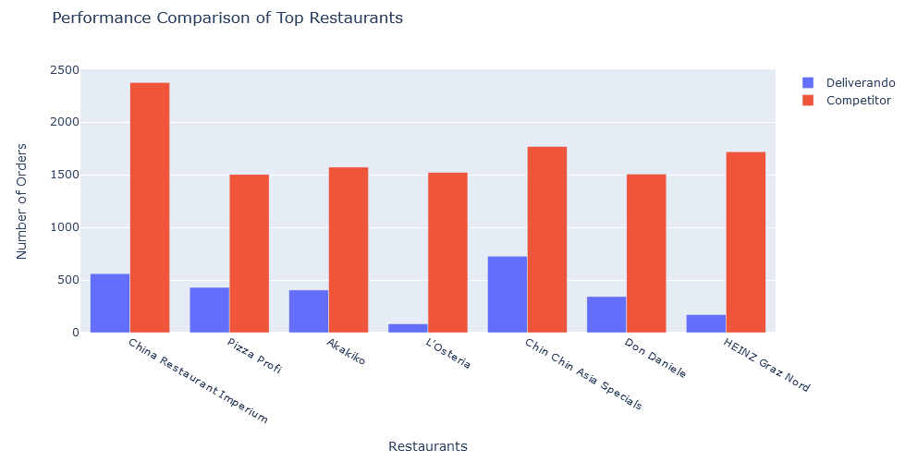
Performance comparison

Slide 7

How can we increment our sales?
Where do we sell more?
Where is the Price Avg. Higher?

Slide 8
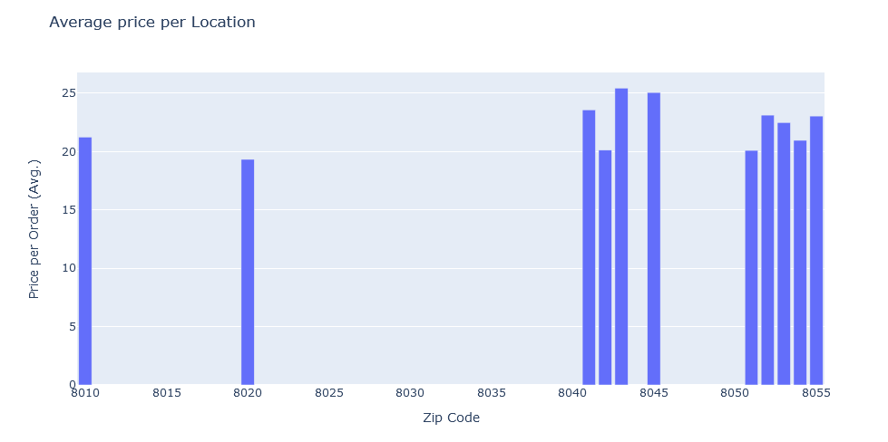
Where are we more?

Slide 9
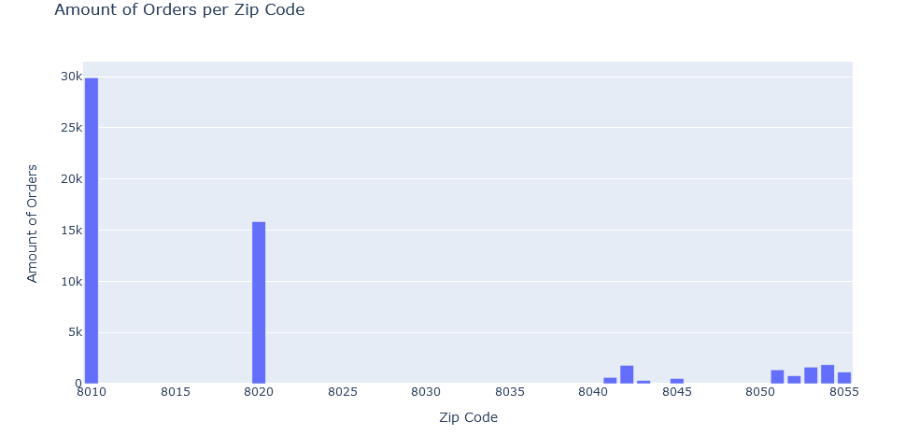
Zip codes: 8036, 8063 & 8077 we are not generating any Profit

Slide 10
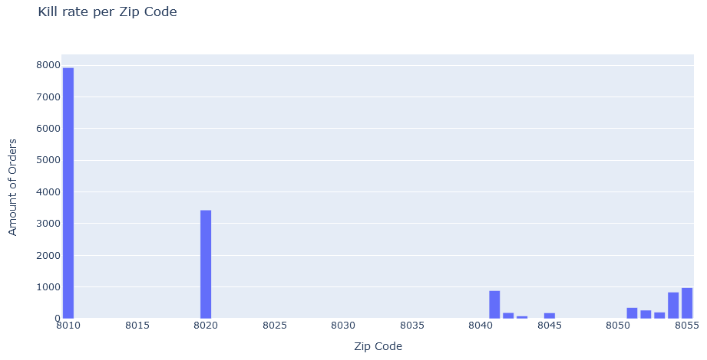
Where do we fail?

Slide 11

Conclusion
Account Managers
Work on our Kill Rate
Marketing

Slide 12

Thank you very much!

